Slide 1
Introduction

Slide 2
Predictive Analytics
Predictive Analytics is a branch of advanced analytics that uses historical data, statistical algorithms, and machine learning techniques to predict future outcomes or behaviors.
Unlike descriptive analytics (which tells what happened) or diagnostic analytics (which explains why it happened), predictive analytics focuses on forecasting what is likely to happen in the future.

Slide 3
Key Components
Historical Data
Statistical & Machine Learning Models
Data Mining & Preprocessing
Predictive Algorithms
Validation & Evaluation

Slide 4
Process of Predictive Analytics
Define Objective
Collect Data
Prepare Data
Choose Model
Train Model
Validate Model
Deploy & Monitor

Slide 5
Machine Learning
The field of study interested in the development of computer algorithms to transform data into intelligent action is known as machine learning.

Slide 6
Uses and abuses of machine learning
A computer may be more capable than a human of finding subtle patterns in large databases, but it still needs a human to motivate the analysis and turn the result into meaningful action.
Machines are not good at asking questions, or even knowing what questions to ask.
They are much better at answering them, provided the question is stated in a way the computer can comprehend.

Slide 7
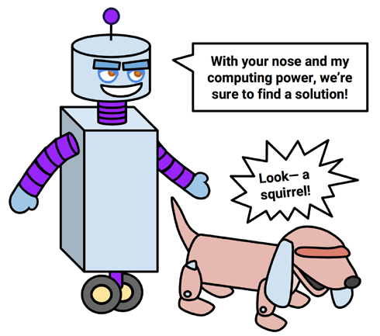

Slide 8
There are various places where machine learning is used.
Identification of unwanted spam messages in e-mail
Segmentation of customer behavior for targeted advertising
Forecasts of weather behavior and long-term climate changes
Prediction of popular election outcomes

Slide 9
Development of algorithms for auto-piloting drones and self-driving cars
Optimization of energy use in homes and office buildings
Discovery of genetic sequences linked to diseases

Slide 10
Although machine learning is used widely and has tremendous potential, it is important to understand its limits.
Machine learning, at this time, is not in any way a substitute for a human brain.
It has very little flexibility to extrapolate outside of the strict parameters it learned and knows no common sense.

Slide 11
With this in mind, one should be extremely careful to recognize exactly what the algorithm has learned before setting it loose in the real-world settings.

Slide 12
How machines learn
Regardless of whether the learner is a human or machine, the basic learning process is similar. It can be divided into four interrelated components:
Data storage utilizes observation, memory, and recall to provide a factual basis for further reasoning.
Abstraction involves the translation of stored data into broader representations and concepts.

Slide 13
Generalization uses abstracted data to create knowledge and inferences that drive action in new contexts.
Evaluation provides a feedback mechanism to measure the utility of learned knowledge and inform potential improvements.

Slide 14
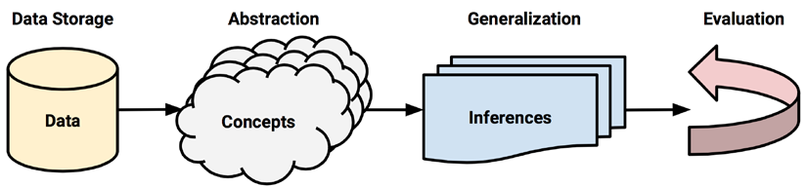

Slide 15
Machine learning in practice
Data collection
Data exploration and preparation
Model training
Model evaluation
Model improvement

Slide 16
Supervised Machine Learning
Machine learning, where the algorithm is trained on labeled data.
The dataset includes both input features and the correct output.
The model learns the mapping from inputs to outputs to make predictions on new, unseen data.

Slide 17
The “supervision” comes from knowing the correct answers during training.
1. Email Spam Detection:
Input: Email content/features (sender, words, links).
Output: Label “Spam” or “Not Spam”.
The model learns from historical emails labeled as spam or not.

Slide 18
Unsupervised Machine Learning
Machine learning, where the algorithm is trained on unlabeled data
The model tries to find hidden patterns, groupings, or structures in the data without being told the correct output.
No “supervision” or labels are provided; the model explores the data on its own.

Slide 19
1. Customer Segmentation in Retail:
Input: Purchase history, browsing behavior, demographics.
Task: Group customers into segments like “bargain hunters” or “premium buyers”.
No labels are provided; the model finds natural groupings.

Slide 20
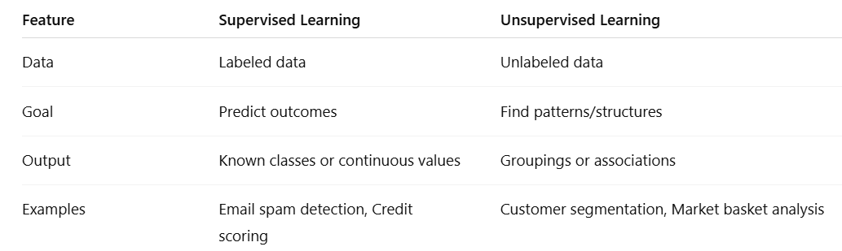
Comparison

